Slide 1

Image Encryption
Jadavpur University B.E IT 4th year
Project Seminar
Submitted by:
Jatin Singh Chug (001811001074)
Shuvrasish Roy (001811001012)
Mentor:
Sujit Kumar Das Sir

Slide 2
Introduction
Encryption: In cryptography, encryption is the process of encoding information. This process converts the original representation of the information, known as plaintext, into an alternative form known as ciphertext. Ideally, only authorized parties can decipher a ciphertext back to plaintext and access the original information.
Image Encryption: Image encryption can be defined in such a way that it is the process of encoding secret image with the help of some encryption algorithm in such a way that unauthorized users can't access it.

Slide 3
Why Image Encryption?
Nowadays, information security is becoming more important in data storage and transmission.
Images are widely used in different-different processes. Therefore, the security of image data from unauthorized uses is important.
Image encryption plays a important role in the field of information hiding.
Image encryption method prepared information unreadable. Therefore, no hacker or eavesdropper, including server administrators and others, have access to original message or any other type of transmitted information through public networks such as internet

Slide 4
Requirements of Image Encryption
Ability to get the pixels of the original image.
Create a strong encryption image such that it cannot be hacked easily.
Faster encryption time such that encrypted image is transferred faster to the person.
Perfection in the original image we obtain after decrypting it.

Slide 5
Our Aim - Ideal Image Encryption
An ideal image encryption algorithm uses a pseudo random number sequence to achieve confusion.
All pixel values must be of equal frequency in the histogram of the encrypted image to eliminate biasing.
If there are multiple pixels with the same value, their encrypted value must not be the same.

Slide 6

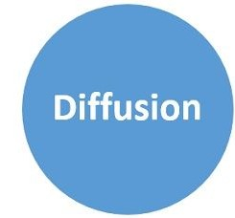
Image Encryption Steps
Confusion
Diffusion

Slide 7
Confusion
The process of changing positions of pixels in the image.
Achieved by permuting the rows and/or columns of the image randomly.
Vagueness is increased in resultant.
Hides the relationship between the cipher image and the key.

Slide 8
2. Diffusion
The process of changing values or intensities of pixels in the image.
We have done this using the bitwise XOR operator and the random number sequence.
Redundancy is increased in resultant.
Hides the statistical relationship between the cipher image and the plain image.

Slide 9
Pseudo Random Number Generator
Pseudo random number generator (PRNG): is any algorithm that is used for generating a sequence of numbers whose properties approximate the properties of sequences of random numbers. The PRNG-generated sequence is not truly random, because it is completely determined by an initial value, called the PRNG's seed (which may include truly random values).
We must use a pseudo random number sequence because while decrypting the image back to its original form, we must know which steps were taken in order to encrypt the image so we can reverse those steps.

Slide 10
Different PRNGs
Middle-square Method
Lehmer Generator
Mersenne Twister
Linear Congruential Generator
Logistic map equation
Lagged Fibonacci Generator

Slide 11
Algorithm Used:
We are going to use the Logistic Map equation to generate a pseudo random number sequence which we will use throughout the process.
Formula: X(n) = r * X(n-1) * ( 1 - X(n-1) )
where,
Xn is a number between zero and one, that represents the ratio of existing population to the maximum possible population
r is the growth rate.

Slide 12
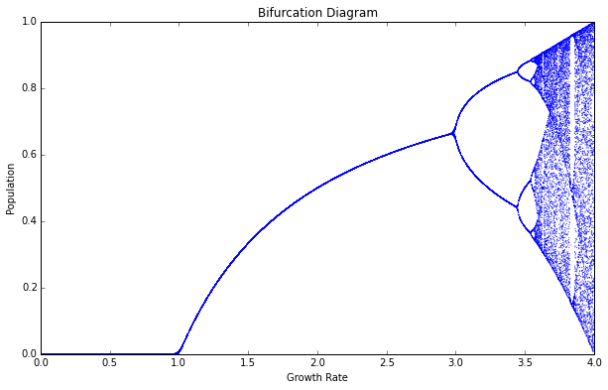
Logistic Map
We use a value close to 4 (r = 3.94) to achieve chaotic behaviour i.e. spread random numbers between 0 and 1.

Slide 13
Confusion using PRNG
We have created a matrix with the same dimensions as the image and filled it with random indices using the logistic map equation.
We are generating one row of random numbers at a time and arg-sorting them. Arg-sorting returns the indices of each element in the sorted form of the list.
Example - 2 21 6 18 7
Arg-sort - 1 5 2 4 3

Slide 14
Confusion using PRNG cntd.
Then we are pushing the arg-sorted row into a matrix (2D array).
Then we are using this matrix to permute the image (confusion) column wise.
Note: The histogram of the confused and original image is same because pixel positions are changed and not the pixel intensities (values)

Slide 15
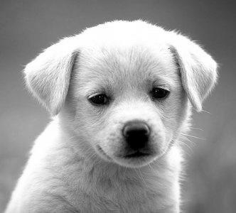

Comparison: Original vs Confused Image
Original Image
Confused Image

Slide 16
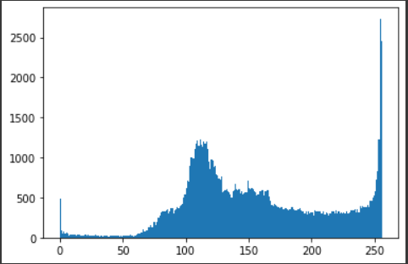
Histogram Comparison: Confused and Original Image
Original Image
Confused Image

Slide 17
Diffusion using PRNG
Since we only need certain pseudo random numbers to change the values of each pixel in the confused image, we generated another matrix with the same dimensions as the original image so we have n*m (size of the image) random values to perform diffusion with.
We are using the same algorithm (Logistic map) but in a different way to achieve this.
We just need random values to do bitwise XOR with to achieve diffusion and we are getting those random values from the logistic map equation and since the values are between 0 and 1, we are multiplying it with a large number and taking the mod with 256 so as to get values within the range 0-255. ( Xn * MAX ) % 256

Slide 18
Diffusion using PRNG cntd.
We are doing the bitwise XOR operation (a ^ b) of each pixel with the respective random number and this changes the value of the pixel in order to achieve diffusion.
We will use the a ^ b ^ b = a property of bitwise XOR operation to decrypt the image.
The values of the random function are so diverse that the frequency of each pixel value in the histogram of the diffused image are almost equal.

Slide 19
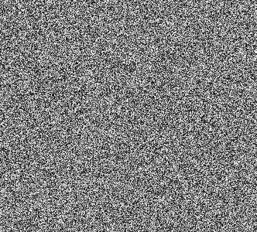
Comparison: Original, Confused and Diffused Image
Original Image
Confused Image
Diffused Image

Slide 20
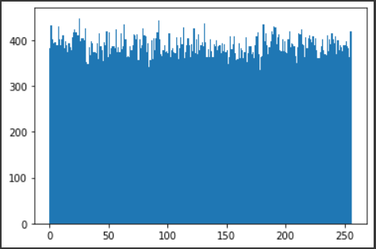
Histogram Comparison: Original and Diffused Image
Original Image
Diffused Image

Slide 21
Decryption
The conversion of encrypted data into its original form is called Decryption. It is generally a reverse process of encryption. It decodes the encrypted information so that an authorized user can only decrypt the data because decryption requires a secret key or password.
In image decryption, we simply undo the steps we did in the encryption phase and achieve the decrypted image which is the original image.
Decryption also requires the pseudo random number sequence as we have encrypted using that sequence.
During our testing, we found out that when we save image as jpg, some of the data is lost (the image is compressed). That is because jpeg is lossy. Changing image type to for example png or bmp solves the issue.

Slide 22
Future Scope
As of now, this algorithm is just implemented for grayscale images. We are thinking of expanding this algorithm for colored images as well.
We are also thinking of trying more algorithms and construct one of our own to generate pseudo random numbers to make this project stand out.
We could make this algorithm so it could take an image name (and a key) as input from user.
We could also make GUI (Graphical User Interface) using tkinter to make this more intuitive for everyone.

Slide 23
Thank You!
Shuvrasish Roy (9027331513, shuvrasish24@gmail.com)
Jatin Singh Chug (8927945574, jscslg27@gmail.com)
Codebase link: https://colab.research.google.com/drive/1Crri_duchx2VDskl0r4HwrL8yVpJMasT?usp=sharing

